Slide 1

ORIENTATION TO COMPUTING - I
L T P: 2 0 0
1
www.lpu.in Lovely Professional University

Slide 2

COURSE WEIGHTAGE & TEXTBOOKS
L-T-P: 2-0-0
[Two Lectures per week] – Credits: 02
[No Lab hours per week]
Course Assessment Model:
Attendance : 20 M
CA : 50 M
ETT : 30 M
Total : 100 M
Reference Text Books (T):
RED HAT RHSCA/RHCE 7 by SANDER VAN VUGT, PEARSON
OPERATING SYSTEM CONCEPTS by ABRAHAM SILBERSCHATZ, PETER B. GALVIN, GERGE GAGNE, WILEY
2
www.lpu.in Lovely Professional University

Slide 3
VISION & MISSION – SCHOOL
VISION:
To be a globally recognized school through excellence in teaching, learning, and research for creating Computer Science professionals, leaders, and entrepreneurs of the future contributing to society and industry for sustainable growth.
MISSION:
M1: To build computational skills through hands-on and practice-based learning with measurable outcomes.
M2: To establish a strong connect with industry for in-demand technology driven curriculum.
M3: To build the infrastructure for meaningful research around societal problems.
M4: To nurture future leaders through research-infused education and lifelong learning.
M5:To create smart and ethical professionals and entrepreneurs who are recognized globally.
3
www.lpu.in Lovely Professional University

Slide 4
COURSE OUTCOMES
Course Outcome | Description
CO 1 | understand the various functional components of a computer system and basics of computer language.
CO 2 | explain operating system components and functionalities, and manage various file systems and processes in Windows and Linux.
CO 3 | describe Linux OS features, installation, directory structure, disk partitions, shell commands, kernel types, and comparison with Windows OS.
CO 4 | predict cohorts based on their technical skillset, understand the relevance of various pathways, and obtain insights of MOOC 's platforms.
CO 5 | understand network components, configurations, and server types, and identify and mitigate security issues effectively.
CO 6 | practice technical concepts of version control using git and GitHub and create technical profiles on different computing platforms
4
www.lpu.in Lovely Professional University

Slide 5
PROGRAM OUTCOMES
PO1: Engineering Knowledge: Apply the knowledge of mathematics, science, engineering fundamentals, and an engineering specialization to the solution of complex engineering problems
PO2: Problem Analysis: Identity, formulate, review research literature, and analyze complex engineering problems reaching substantiated conclusions using the first principles of mathematics, natural sciences, and engineering sciences
PO3: Design/Development of solutions: Design solutions for complex engineering problems and design system components or processes that meet the specified needs with appropriate consideration for the public health and safety, and the cultural, societal, and environmental considerations
PO4: Conduct investigations of complex problems: Use research-based knowledge and research methods including design of experiments, analysis, and interpretation of data, and synthesis of the information to provide valid conclusions
PO5: Modern tool usage: Create, select, and apply appropriate techniques, resources, and modern engineering
PO6: The engineer and society: Apply reasoning informed by the contextual knowledge to assess societal, health, safety, legal and cultural issues and the consequent responsibilities relevant to the professional engineering practice
5
www.lpu.in Lovely Professional University

Slide 6
PROGRAM OUTCOMES
PO7: Environment and sustainability: Understand the impact of the professional engineering solutions in societal and environmental contexts, and demonstrate the knowledge of, and need for sustainable development
PO8: Ethics: Apply ethical principles and commit to professional ethics and responsibilities and norms of the engineering practice.
PO9: Individual and team work: Function effectively as an individual, and as a member or leader in diverse teams, and in multidisciplinary settings
PO10: Communication: Communicate effectively on complex engineering activities with the engineering community and with society at large, such as, being able to comprehend and write effective reports and design documentation, make effective presentations, and give and receive clear instructions
PO11: Project management and finance: Demonstrate knowledge and understanding of the engineering and management principles and apply these to one’s own work, as a member and leader in a team, to manage projects and in multidisciplinary environments.
PO12: Life-long learning: Recognize the need for, and have the preparation and ability to engage in independent and life-long learning in the broadest context of technological change.
6
www.lpu.in Lovely Professional University

Slide 7
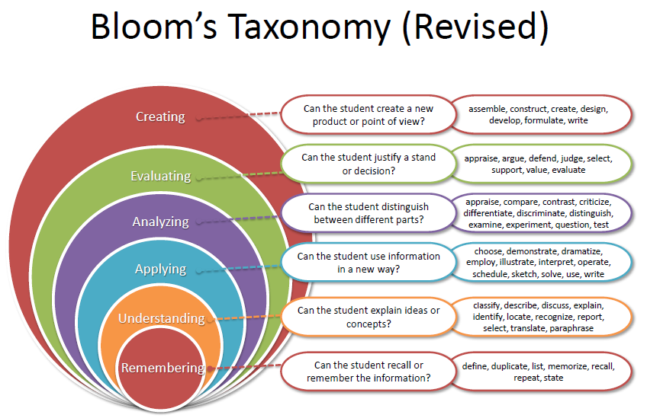
BLOOM’s TAXONOMY
7
www.lpu.in Lovely Professional University

Slide 8
WHAT are COHORT’s?
A group of students of a common programme who intend to attain similar characteristics by means of learning similar skills in order to target a particular career opportunity.
www.lpu.in Lovely Professional University

Slide 9
COHORT’s PURPOSE
Student shall be able to have a goal-oriented approach to his/her career
Student identifies the goal in the very first year
Students shall be able to follow the stage-wise career progression.
Early identification of the skill set required for a selected goal.
www.lpu.in Lovely Professional University

Slide 10
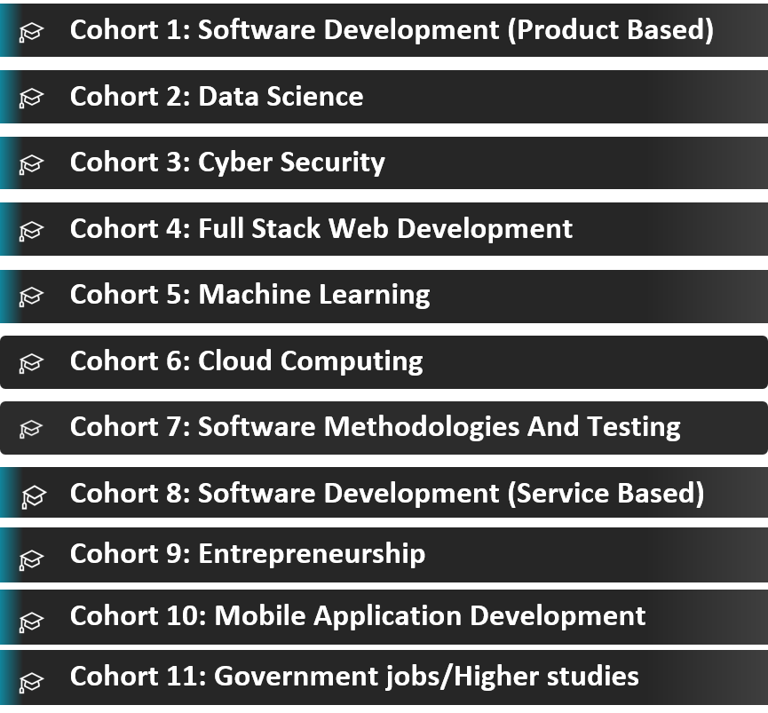
COHORT’s
OUTLINE of COHORT’s
www.lpu.in Lovely Professional University

Slide 11
CONTENTS
Unit I
Computer Systems: Basic structure of a computer and its working, Computer associated peripherals, Memories - RAM, ROM, Secondary storage devices, System Configuration – features and comparison (SSD vs hybrid, types of RAMs, Processors - cores/threads), BIOS Configuration, Compare and contrast PC connection interface (USB, SATA, HDMI, NFC, Bluetooth), RAID, GPU basics,
Synchronization across CPU and GPU.
Computer Languages: Machine language, Assembly language, High-level language, Steps in the development of a program, Compilation and Execution, Compiler, Interpreter, Assembler.
Unit II
Operating System: Operating Systems and its components, Windows Operating System Versions and features, Installation Process, Directory Hierarchy of Windows Operating System (Single level and multiple levels), Bootloader.
File system management: File system basics, Types of file systems ( FAT, GFT, HFS, NDFS, UDF, Extended file systems), Pipes and redirection, Searching the file system using find and grep with simple regular expressions, Basic process control using signals, Pausing and Resuming process from a Linux terminal, terminating a process, Adding/removing from search path using PATH variable.
11
www.lpu.in Lovely Professional University

Slide 12
CONTENTS
Unit III
Linux Operating System: Linux OS and its features, Distribution versions, installation process, and Directory Hierarchy of Linux System (single level and multiple levels)., Partitions: Understanding disk partitions and obtaining partition information using system tools, Comparison of Windows and Linux OS, and Virtual Machines.
Other Shell commands: ls, cat, man, cd, touch, cp, mv, rmdir, mkdir, rm, chmod, pwd, ps, kill, etc, Kernel and types of kernels
Unit IV
Cohorts and Skill Sets: Introduction to Cohorts, Purpose of Cohorts, Companies, Skills required and skill sources for different Cohorts (Internal and External)
Types of Cohorts: Cloud Computing, Cyber Security, Data Science, Full Stack Development, Machine Learning, Software Methodologies and Testing, UI/UX, Metaverse and Internet of Things, Job Roles for Different Cohort
Pathways : Introduction to Pathways, Purpose of Pathways, Job Roles for Different Pathways, Types of Pathways: Product Based, Service Based, Government Jobs, Higher studies, Entrepreneurship
MOOCs and Hackathons : Introduction to MOOCs and Hackathons, Types of MOOCs, Various MOOCs Platforms, Benefits of MOOCs, Globally Recognized Hackathons and Competitions, MAANG Companies
12
www.lpu.in Lovely Professional University

Slide 13
CONTENTS
Unit V
Computer Network and Communication: Network types (wired and wireless), Network topologies, Network communication devices (Routers, Switches, Modems, Hubs, access point), Setting IP addresses, sharing files and folders, Remote Login, SSH, Wireless Security (http vs https), Client Server model, Types of Servers (Proxy servers, Application server, Web server, File server, Database server, Synchronization server, Log server).
Security Essentials: Basic security threats (malwares, Phishing, Social engineering, Password cracking), Password management (Password complexity, Change default passwords), Open Wi-Fi vs. secure Wi-Fi, Multi Factor authentication, Admin vs. user vs. guest Account.
Unit VI
Version Control: Overview of Git and GitHub, Install Git and create a GitHub account, Create a local Git repository, Add a new file to the repository, Create a commit, Creation of a new Branch
Profile Creation: Figma, GitHub, Stack overflow, HackerRank, HackerEarth, GeeksforGeeks.
13
www.lpu.in Lovely Professional University

Slide 14
WHY ORIENTATION TO COMPUTING ?
As a computer science student in the beginner stage you need to know how the various things in a computer work and how the computer is used in multiple instances.
You need to understand the brief descriptions of subjects that will be further explored in future subjects through your degree program.
14
www.lpu.in Lovely Professional University

Slide 15

EVALUATION CRITERIA
CA1: MCQ: It will be objective-type containing 30 MCQ questions of 1 mark each, which includes analytical and logical scenario-based questions.
CA2: Non-Technical Online MOOC course: Students will complete one short-duration Non-Technical MOOC of their choice from the approved list only and submit the completion certificate.
Link for Approved list :
https://docs.google.com/spreadsheets/d/1dsX2P_--m8cHZayyj0DhjfJ2crMco93QQVsBAQoM_wU/edit?usp=sharing
***The spreadsheet list will be updated well before in time.
(Note – While going through the links mentioned in the spreadsheet prefer to use your internet connection (personal hotspot) in case it’s not working on WIFI.)
Total 30 Marks
Certificate Submission – 15 Marks
Viva/Presentation – 15 Marks
15
www.lpu.in Lovely Professional University

Slide 16
EVALUATION CRITERIA
CA3: Portfolio/CV creation: Students will prepare a CV, register in one technical MOOC create profiles, and take insights into various platforms like GitHub, Stack Overflow, Linked In, Hacker Rank, Hacker Earth, etc.
Rubrics to be followed:
CV creation [5 marks]
Technical MOOC Registration Proof [5 Marks]
*** Students will select MOOCs of their choice from the approved list only which will be shared by the teacher well before time. This MOOC needs to be completed in the winter break and the completion certificate of this MOOC will be considered as CA1 of CSE121 (ORIENTATION TO COMPUTING – II) in 2nd semester along with its evaluation.
GitHub with repositories and forks [10 marks]
Profile creation and activities by students on various technical platforms [10 marks]
16
www.lpu.in Lovely Professional University

Slide 17
EVALUATION CRITERIA
Out of these three CA’s, CA3 is Mandatory, and out of the remaining two CA’s 1 best will be considered.
Note:
MTE: There will be no MTE applicable for this course.
ETE: The ETE of this course involves MCQs-based analytical, logical, and scenario-based questions. There will be a 0.25% negative marking in the MCQ
 | Weightage
CA1: Multiple Choice Questions (MCQs) | 50%
CA2: Non-Technical Online MOOC course
CA3: Portfolio/CV creation (Mandatory) | 50%
(Best of One)
17
www.lpu.in Lovely Professional University

Slide 18
Mapped MOOC For CA Exemption
MOOCs are the best way to learn the technologies apart from regular courses. To encourage the students for this, one MOOC is approved and one CA exemption is given upon completion. Details of this MOOC are:
The first MOOC is related to LINUX commands which are also part of the syllabus(3rd unit). Linux commands are fundamental, and their basics are essential for coming courses like Operating Systems and Cyber Security.
The second MOOC is related to Git and GitHub which is also a part of the syllabus (6th unit). Git is an open-source version control tool and Git hub is a pay-per-use online service built to run Git in the cloud.
Benefits of this MOOC:
Skill Upgradation
1 CA exemption (Which will help you in improving the CA Marks in case of less marks in any CA except CA3)
Title of the MOOC | Duration | LINK | Exemption
Linux Commands and Shell Scripting | 15 hours | https://skillera.org/ExploreCourses | 1 CA (Except mandatory one )
Introduction to Git and GitHub | 27 hours | https://www.coursera.org/learn/introduction-git-github | 1 CA (Except mandatory one )
18
www.lpu.in Lovely Professional University

Slide 19
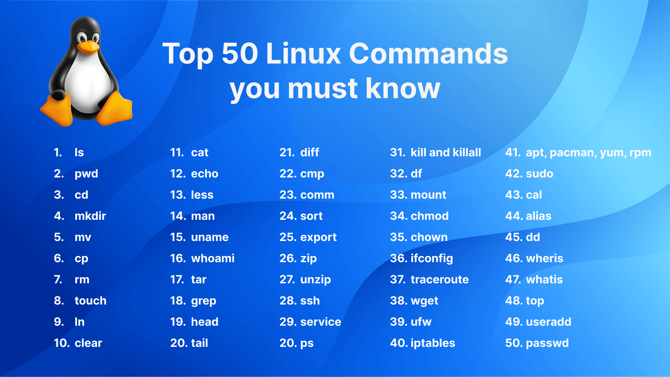
DETAILS of COURSE ENRICHMENT ACTIVITIES
As this course is a STAR Course. Certain activities will be conducted throughout the course duration. The details of the activities are given below:
Write a Blog: Each student will write a blog on the given topic and publish it on Medium sub stack or any other social platform
Watch a Great Video: Faculty will provide a pre-assigned technical video on the latest trends and technologies in computer science independently and write a 250-word report summarizing the key takeaway.
Tool-based Execution of Linux Commands: Faculty will demonstrate the execution of different commands in Ubuntu or other Linux platforms/PowerShell
19
www.lpu.in Lovely Professional University

Slide 20

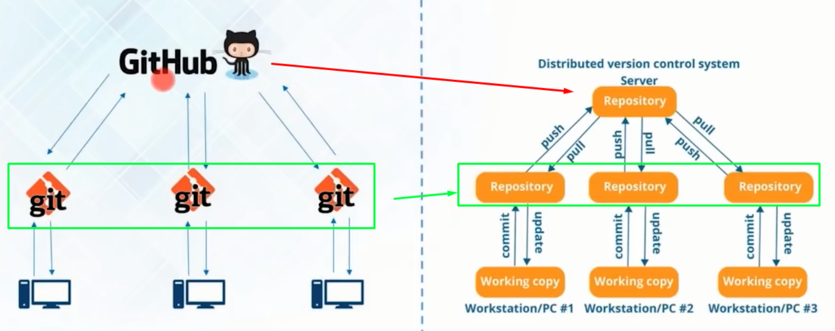
DETAILS of COURSE ENRICHMENT ACTIVITIES
D. Tech-I Follow: Each student will receive a designated company name and will be tasked with researching and analyzing the company's business processes. This includes gathering information about the necessary skills, as well as exploring details regarding salary packages and more.
Note: Students will present his/her findings in a class within 3 minutes.
Interactive Demonstration of Network Security Threats: The session will feature a hands-on, educational demonstration focusing on different types of network security threats.
Your First Commit: Utilizing web-based software like GitHub, a live demonstration will be conducted to offer insights into the version control systems and their practical applications.
20
www.lpu.in Lovely Professional University

Slide 21
OPEN EDUCATIONAL RESOURCE
Unit mapped | Broad topic | Sub Topic | Source Type | Source Title | *%age mapping (approx.) | Source URL
Unit I | Computer Systems | Memories RAM, ROM, Secondary storage devices | Weblink | Secondary Storage Devices in Computer Organization | 100% | https://www.javatpoint.com/secondary-storage-devices-in-computer-organization https://www.tmv.edu.in/pdf/Distance_education/BCA%20Books/BCA%20I%20SEM/BCA-121%20Computer%20Fundamental.pdf
Unit I | Computer Systems | Memories RAM, ROM, Secondary storage devices | Weblink | Secondary Storage: Definition & Devices | 100% | https://teachcomputerscience.com/secondary-storage https://www.tmv.edu.in/pdf/Distance_education/BCA%20Books/BCA%20I%20SEM/BCA-121%20Computer%20Fundamental.pdf
Unit I | Computer Systems | System Configuration – features and comparison (SSD vs hybrid, RAM types) | Weblink | Computer System Configuration | 60% | https://www.tmv.edu.in/pdf/Distance_education/BCA%20Books/BCA%20I%20SEM/BCA-121%20Computer%20Fundamental.pdf
Unit II | Operating System | Operating Systems and its components, Windows OS Versions and features | Weblink | Operating Systems Basics | 70% | https://softwarekeep.com/en-in/blogs/comparisons/windows-os-history-timeline?pb=0
21
www.lpu.in Lovely Professional University

Slide 22
OPEN EDUCATIONAL RESOURCE
Unit mapped | Broad topic | Sub Topic | Source Type | Source Title | *%age mapping (approx.) | Source URL
 | File System Management | Types of file systems, Basic process control using signals | Weblink | File System and Management | 80% | https://www.geeksforgeeks.org/file-systems-in-operating-system/
Unit III | Linux Operating System | Linux OS features, Distribution versions, installation, Directory Hierarchy | Weblink | Linux Operating System Basics | 100% | https://www.jbiet.edu.in/pdffls/IT-coursematerial/Linux.pdf
Unit III | Linux Operating System | Other Shell commands, Kernel and types of kernels | Weblink | Basic Shell Commands | 100% | https://www.jbiet.edu.in/pdffls/IT-coursematerial/Linux.pdf
Unit IV | Cohorts and Skill Sets | Types of Cohorts, Skills required for different Cohorts | Weblink | Introduction to Cohorts and Skill Sets | 80% | https://www.lpu.in/inst-performance/identification-of-cohorts-and-career-pathways.php https://www.knowledgehut.com/blog/career/career-options-after-computer-engineering#jobs-after-engineering-in-computer-science%C2%A0
Unit IV | Pathways | Purpose of Pathways, Job Roles for Different Pathways | Weblink | Career Pathways and Development | 80% | https://www.gse.harvard.edu/ideas/education-now/24/02/pathways-careers-purpose
22
www.lpu.in Lovely Professional University

Slide 23
OPEN EDUCATIONAL RESOURCE
Unit mapped | Broad topic | Sub Topic | Source Type | Source Title | *%age mapping (approx.) | Source URL
Unit II | File System Management | Types of file systems, Basic process control using signals | Weblink | File System and Management | 80% | https://www.geeksforgeeks.org/file-systems-in-operating-system/
Unit III | Linux Operating System | Linux OS features, Distribution versions, installation, Directory Hierarchy | Weblink | Linux Operating System Basics | 100% | https://www.jbiet.edu.in/pdffls/IT-coursematerial/Linux.pdf
Unit III | Linux Operating System | Other Shell commands, Kernel and types of kernels | Weblink | Basic Shell Commands | 100% | https://www.jbiet.edu.in/pdffls/IT-coursematerial/Linux.pdf
Unit IV | Cohorts and Skill Sets | Types of Cohorts, Skills required for different Cohorts | Weblink | Introduction to Cohorts and Skill Sets | 80% | https://www.lpu.in/inst-performance/identification-of-cohorts-and-career-pathways.php https://www.knowledgehut.com/blog/career/career-options-after-computer-engineering#jobs-after-engineering-in-computer-science%C2%A0
Unit IV | Pathways | Purpose of Pathways, Job Roles for Different Pathways | Weblink | Career Pathways and Development | 80% | https://www.gse.harvard.edu/ideas/education-now/24/02/pathways-careers-purpose
23
www.lpu.in Lovely Professional University

Slide 24
OPEN EDUCATIONAL RESOURCE
Unit mapped | Broad topic | Sub Topic | Source Type | Source Title | *%age mapping (approx.) | Source URL
Unit V | Computer Network and Communication | Network types, Network topologies, Network communication devices | Weblink | Computer Network Basics | 80% | https://open.umn.edu/opentextbooks/textbooks/771
Unit V | Security Essentials | Basic security threats, Password management, WiFi security | Weblink | Cyber Security Essentials | 70% | https://open.umn.edu/opentextbooks/textbooks/771
Unit VI | Version Control | Overview of Git and GitHub, creating repository, commits, branches | PDF | Getting Started with GitHub | 90% | https://education.github.com/git-cheat-sheet-education.pdf
Unit VI | Profile Creation | Figma, GitHub, Stack Overflow, HackerRank, GeeksforGeeks | PDF | Guide to Creating Developer Profiles | 90% | https://liveyourmessage.com/social-media-profile/
24
www.lpu.in Lovely Professional University

Slide 25

25
www.lpu.in Lovely Professional University

